Slide 1

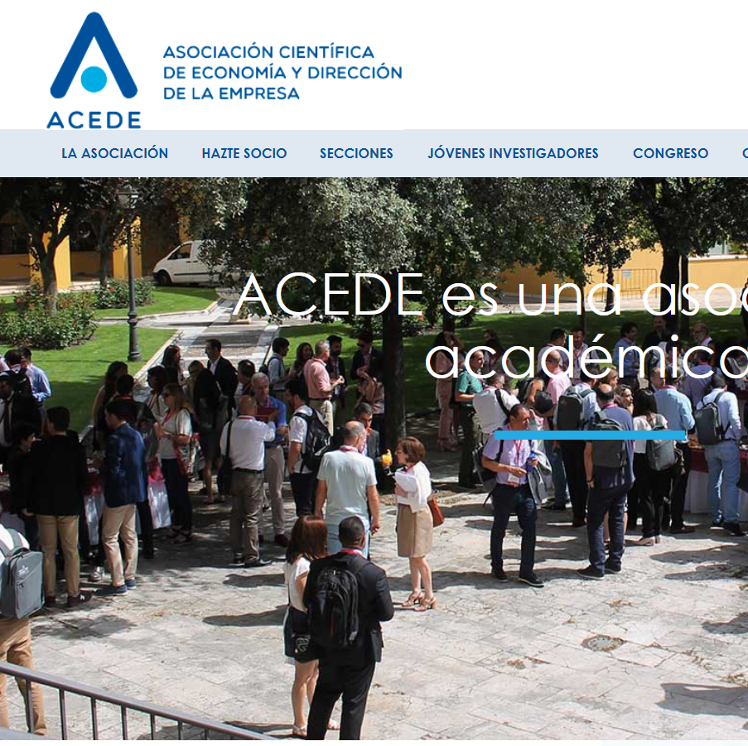
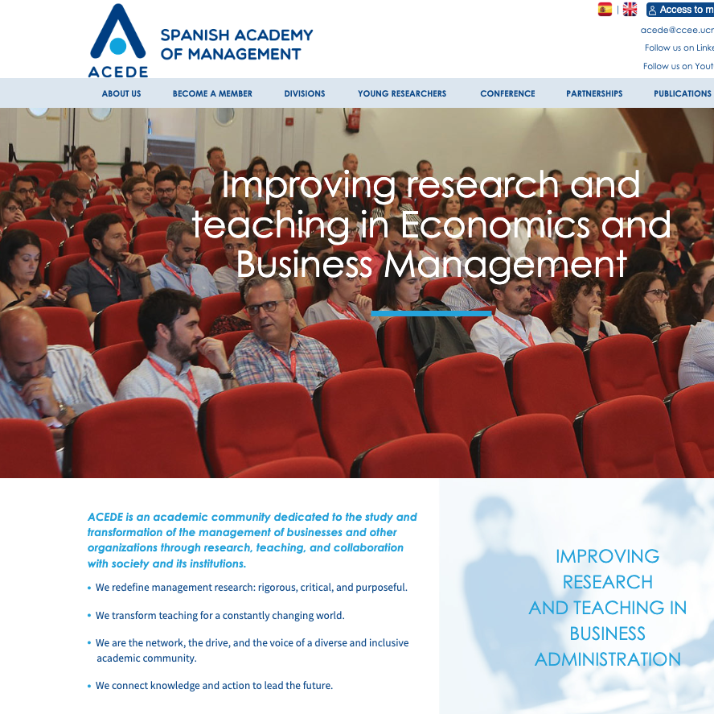

https://www.acede.org/en/
https://www.linkedin.com/company/asociacionacede/

Slide 2
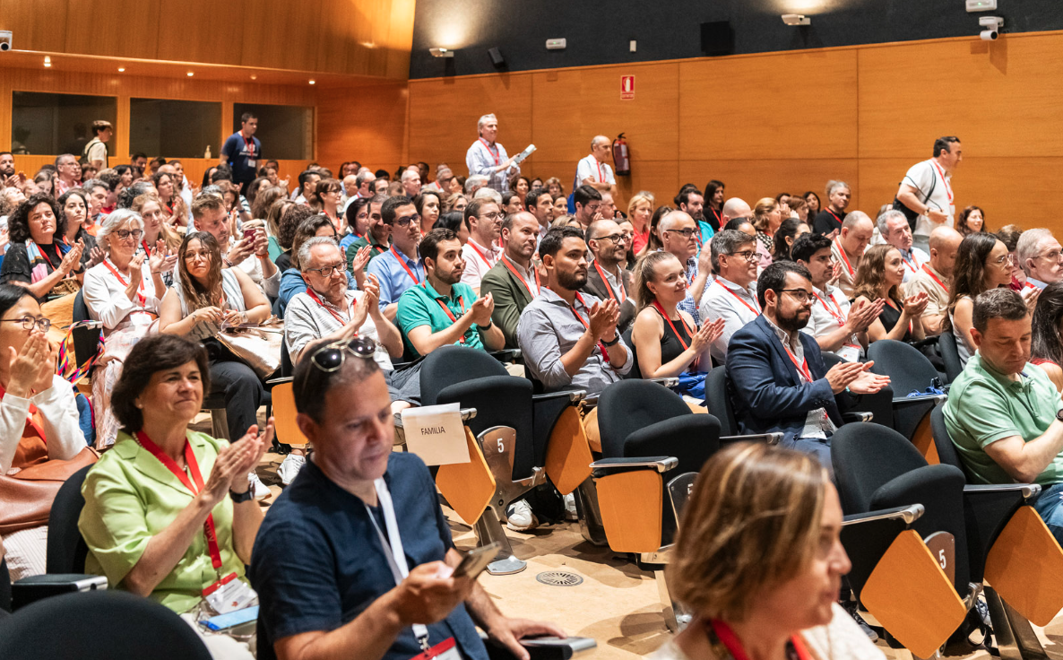
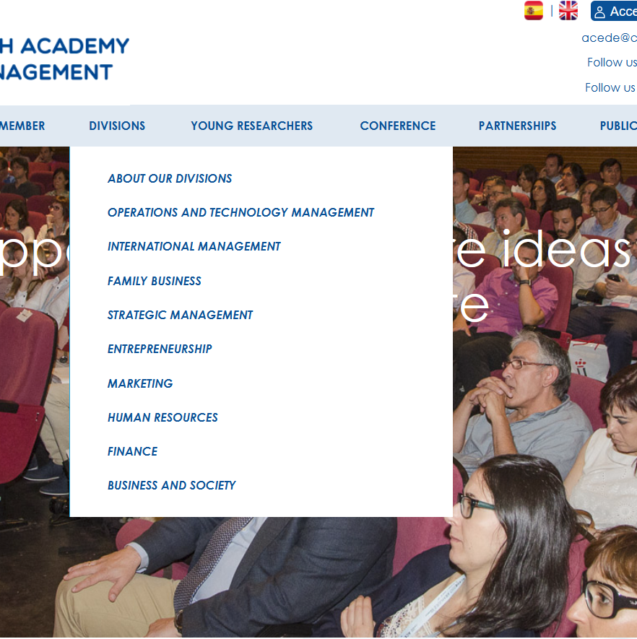

Who are we?
ACEDE is Spain’s leading academic association in Management and Business Economics, connecting researchers, educators, and institutions.
Our mission: advance rigorous research, professional development, and scholarly exchange with real societal relevance.
How we operate: a member-driven community that organizes flagship events and year-round initiatives structured around thematic divisions.

Slide 3
ACEDE in numbers & trajectory
Founded in 1990
900+ members (2025) — primarily based in Spain, with representation across nearly all Spanish universities and business schools
9 thematic divisions: Operations & Technology Management; Strategy; Entrepreneurship; Marketing; Finance; Human Resources; Business & Society; International Management; Family Business
Early Career Network (ECN) — created in 2022, with ~150 highly active early-career researchers
Annual international conference (June): ~550 attendees
Year-round activity: division workshops and webinars
Monthly newsletter connecting members and announcing opportunities
Business Research Quarterly (BRQ): ACEDE’s flagship journal

Slide 4
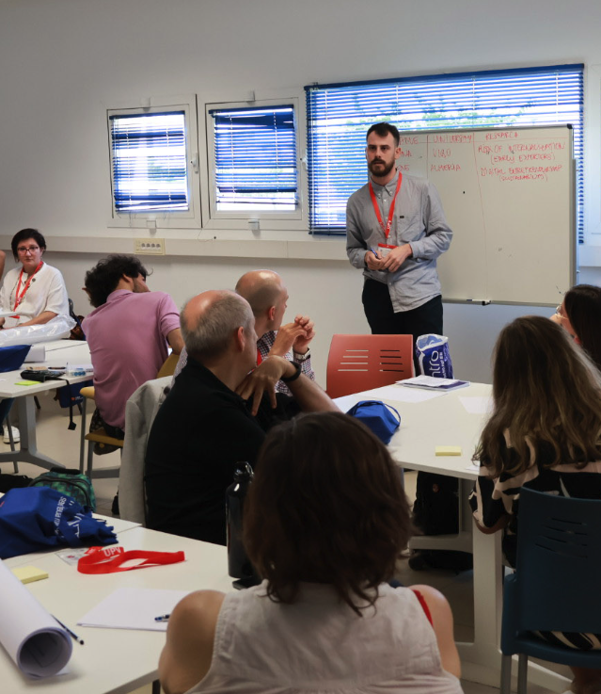
What do we do?
Flagship initiatives (annual)
  Annual in-person conference: ~550 attendees · ~400 presentations
  In-person division workshops: ~40–120 participants
  Online training & professional development: ~50 virtual events/year · ~30–180 participants per event
  Doctoral Program Network: a structured platform connecting doctoral students and supervisors to share training, mentoring, and mobility opportunities
International reach
  Business Research Quarterly (BRQ): ACEDE’s flagship journal with strong international visibility in major academic rankings
  Global engagement with international visiting scholars for seminars and doctoral development activities

Slide 5




Our partnerships

Slide 6
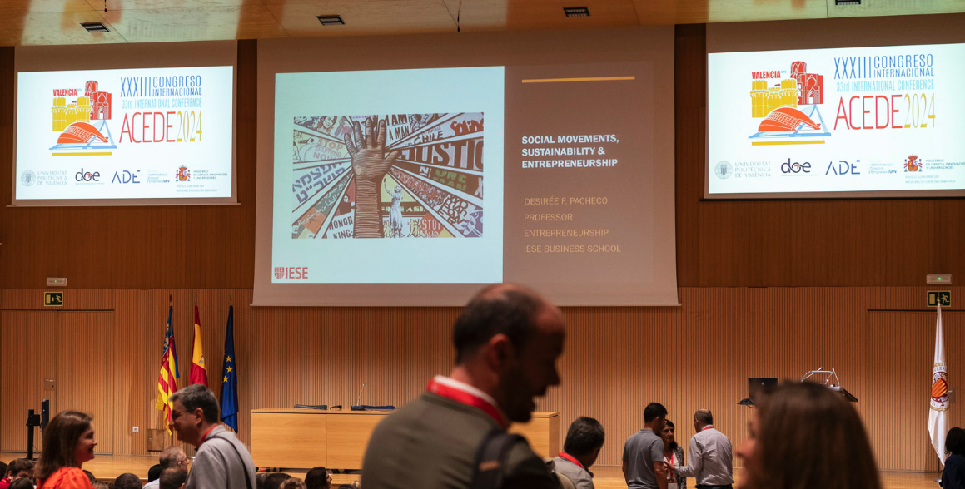
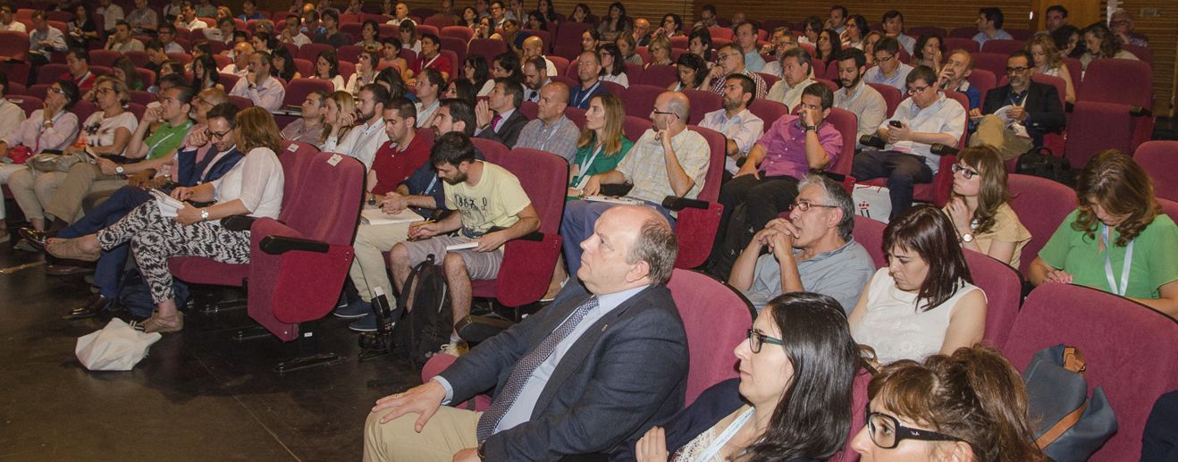
What values do we stand for?
Ethical research conduct
We promote high-quality scholarship grounded in robust methods (quantitative and qualitative), with transparency and practices that enable reproducibility and replicability.
Academic relevance and societal impact
We support research and teaching that advances knowledge and contributes to collective well-being, aiming for positive impact on today’s major economic, social, and environmental challenges.
Inclusivity and diversity
We foster a diverse and inclusive association, welcoming a wide range of voices, cultures, genders, and scholarly approaches in an environment of respect and collaboration.
Community
We build a strong sense of belonging, support members’ needs, act as an interlocutor with institutions, and strengthen meaningful connections through mutual support and collaboration.

Slide 7

Thanks!
https://www.acede.org/en/
https://www.linkedin.com/company/asociacionacede/

